Slide 1
Time series analysis

Slide 2
Generally, data sets could be of 4 main grades:
time series data, a set of observations on the values that a variable takes at different times, used for temporal measurements, forecasting trend
spatial data where the observations typically relate to geographical locations
cross-sectional data, data of one or more variables, collected at the same point in time, as analyzing data from a population, or a representative subset, at a specific point in time
longitudinal or panel data, observations of multiple phenomena over multiple time periods for the same data units; involves repeated observations of the same variables (e.g., people) over periods of time; can prove cause and effect, but time-consuming and expensive
A time series is a series of data points indexed (or listed or graphed or plotted via run charts (a temporal line chart)) in time order; a sequence taken at successive equally spaced points in time; a sequence of discrete-time data, eg, letters and words, seasonal precipitation, heights of ocean tides, counts of sunspots, the Dow Jones Industrial Average, etc.

Slide 3
Time series are used in any domain of applied science and engineering which involves temporal measurements, statistics, signal processing, pattern recognition, econometrics, mathematical finance, weather forecasting, earthquake prediction, electroencephalography, control engineering, astronomy, communications engineering.
In the context of pattern recognition and machine learning, time series analysis can be used for clustering, classification, query by content, anomaly detection as well as forecasting.
A time series as having a natural temporal ordering applied to real-valued, continuous data, discrete numeric data, or discrete symbolic data (sequences of characters, such as letters and words) with the primary goal of time series analysis to forecast.
Time series data means that we have data from one unit, over many points in time. Panel data (or time series cross section) means that we have data from many units, over many points in time.
The big difference is that in a time series we can measure the overall change in the measurement over time (or by group) while in a longitudinal analysis you actually have the measurement of change at the individual level.

Slide 4
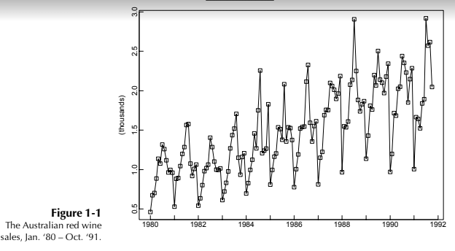
Example1 : Australian red wine sales; WINE.TSM
Figure 1.1 shows the mont hly sales (in kiloliters) of red wine by Australian winemakers from January 1980 through October 1991. In this case the set T0 consists of the 142 times {(Jan. 1980), (Feb. 1980), ... ,(Oct. 1991)}. Given a set of n observations made at uniformly spaced time intervals, it is often convenient to rescale the time axis in such a way that T0 becomes the set of integers {1, 2,...,n}. In the present example this amounts to measuring time in months with (Jan. 1980) as month 1. Then T₀ is the set {1, 2,..., 142}. It appears from the graph that the sales have an upward trend and a seasonal pattern with a peak in July and a trough in January.

Slide 5
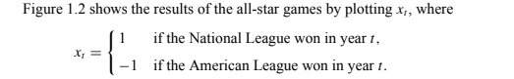
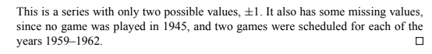
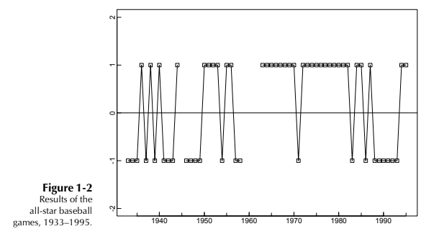
Example 2: All-star baseball games, 1933–1995

Slide 6
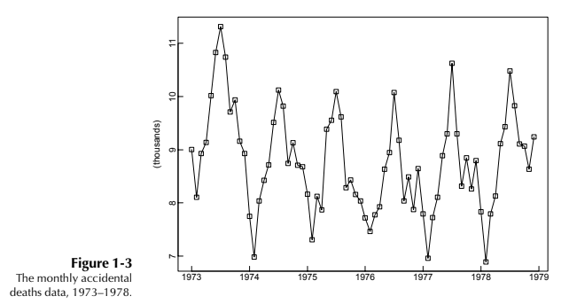
Example3 : Accidental deaths, U.S.A., 1973–1978; DEATHS.TSM
Like the red wine sales, the monthly accidental death figures show a strong seasonal pattern, with the maximum for each year occurring in July and the minimum for each year occurring in February. The presence of a trend in Figure 1.3 is much less apparent than in the wine sales. we shall consider the problem of representing the data as the sum of a trend, a seasonal component, and a residual term.

Slide 7
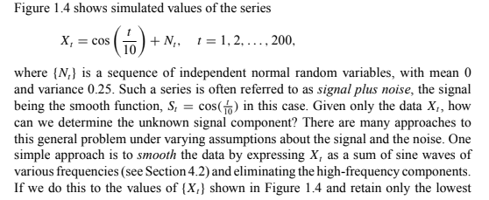
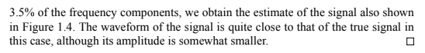
Example4 : A signal detection problem; SIGNAL.TSM

Slide 8
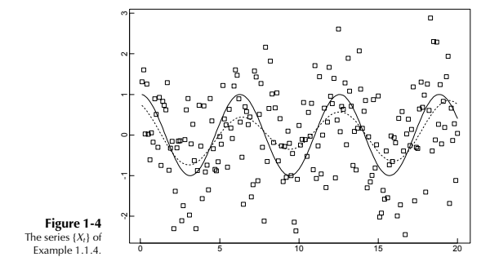

Slide 9
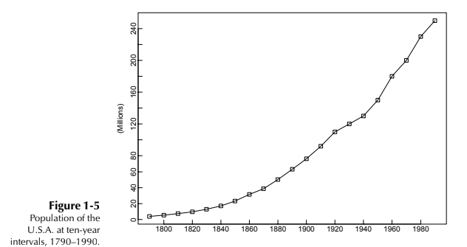
Example5: Population of the U.S.A., 1790–1990; USPOP.TSM
The population of the U.S.A., measured at ten-year intervals, is shown in Figure 1.5. The graph suggests the possibility of fitting a quadratic or exponential trend to the data. We shall explore this further.

Slide 10
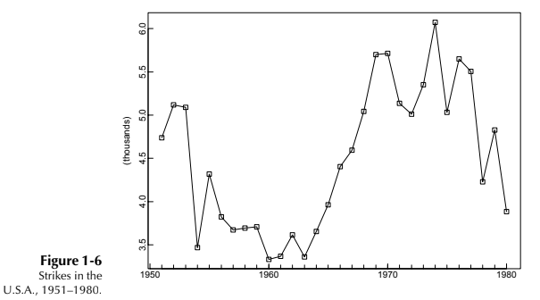
Example 6: Number of strikes per year in the U.S.A., 1951–1980; STRIKES.TSM
The annual numbers of strikes in the U.S.A. for the years 1951–1980 are shown in Figure 1.6. They appear to fluctuate erratically about a slowly changing level.

Slide 11
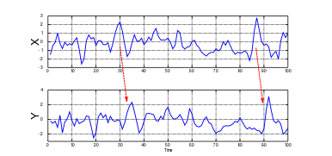
The Granger statistical causality test, which is not any causality, is widely applied in econometrics to determine whether one time series is useful in forecasting another. Rather than testing whether Y causes X, the Granger causality tests whether Y forecasts X. When time series X Granger-causes time series Y, the patterns in X are approximately repeated in Y after some time lag. Thus, past values of X can be used for the prediction of future values of Y.

Slide 12
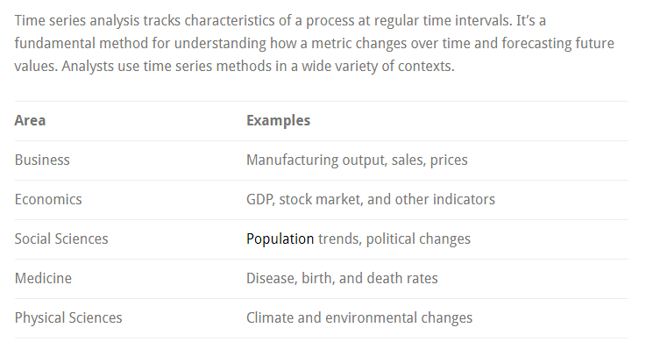

Slide 13
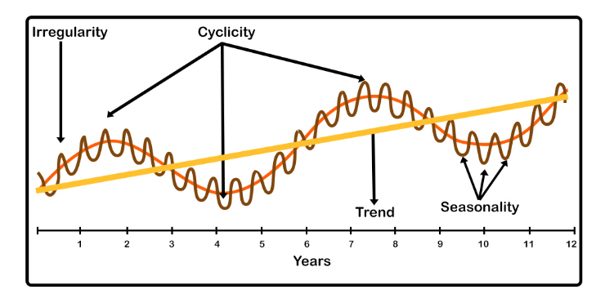
Components of time series
Trend: This is the long-term increase or decrease in the data. The trend could be increasing or decreasing as well as linear or nonlinear.
Irregular: This component is uncertain. In every time series, there’s an unpredictable component that makes it a random variable, resulting from short-term fluctuations in a series that are not systematic, and in some instances not predictable.
Seasonality: The regular pattern of up and down fluctuations in a time series. It may be a short term variation occurring due to seasonal factors. In seasonality, there’s a situation in which the data experiences regular and predictable changes.
Cyclicity: In straightforward terms, this variation is caused by circumstances that repeat at irregular intervals. The length of the cycle is described as the period.

Slide 14
A General Approach to Time Series Modeling
Plot the series and examine the main features of the graph, checking in particular whether there is
(a) a trend,
(b) a seasonal component,
(c) any apparent sharp changes in behavior,
(d) any outlying observations.
• Remove the trend and seasonal components to get stationary residuals . To achieve this goal it may sometimes be necessary to apply a preliminary transformation to the data. For example, if the magnitude of the fluctuations appears to grow roughly linearly with the level of the series, then the transformed series {ln X1,..., ln Xn} will have fluctuations of more constant magnitude. See, for example, Figures 1.1 and 1.7. (If some of the data are negative, add a positive constant to each of the data values to ensure that all values are positive before taking logarithms.) There are several ways in which trend and seasonality can be removed (see Section 1.5), some involving estimating the components and subtracting them from the data, and others depending on differencing the data, i.e., replacing the original series {Xt} by {Yt : Xt − Xt−d } for some positive integer d. Whichever method is used, the aim is to produce a stationary series, whose values we shall refer to as residuals.

Slide 15
Choose a model to fit the residuals, making use of various sample statistics including the sample autocorrelation function to be defined
Forecasting will be achieved by forecasting the residuals and then inverting the transformations described above to arrive at forecasts of the original series {Xt}.
An extremely useful alternative approach touched on only briefly in this book is to express the series in terms of its Fourier components, which are sinusoidal waves of different frequencies (cf. Example .4). This approach is especially important in engineering applications such as signal processing and structural design. It is important, for example, to ensure that the resonant frequency of a structure does not coincide with a frequency at which the loading forces on the structure have a particularly large component.

Slide 16
Goals of Time Series Analysis
Time series analysis seeks to understand patterns in changes over time. Statisticians refer to these patterns as the components of a time series and they include trends, cycles, and irregular movements. When these components exist in a time series, the model must account for these patterns to generate accurate forecasts, such as future sales, GDP, and global temperatures.
In addition to these patterns, time series models typically incorporate the fact that time flows in one direction. Past events can influence future observations but not the other way around. Additionally, events close together in time often have a stronger association than more distant observations. While these ideas are obvious to us, statisticians had to build them into how these models work.
Like all data, time series data contain random fluctuations. This randomness can obscure the underlying patterns. Smoothing techniques cancel out these fluctuations to more clearly unveil the trends and cycles.

Slide 17
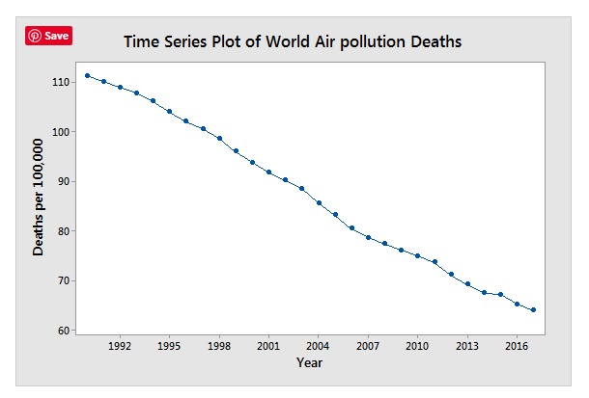
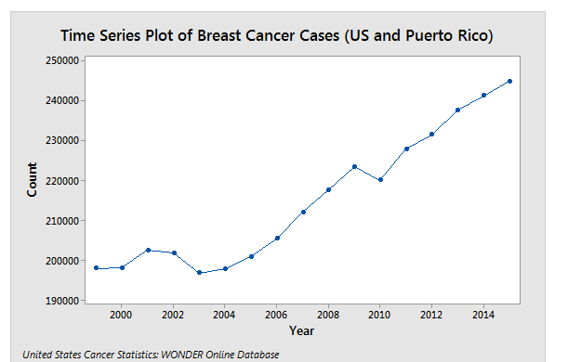
Trends
Trends are a long-term tendency of a time series to either increase or decrease. For example, the two plots below show trends over time. At a glance, we can determine that air pollution deaths are decreasing over the years. On the other hand, cases of breast cancer in men and women are increasing over the years. If we need to generate forecasts for future years, our model would include these trends.

Slide 18
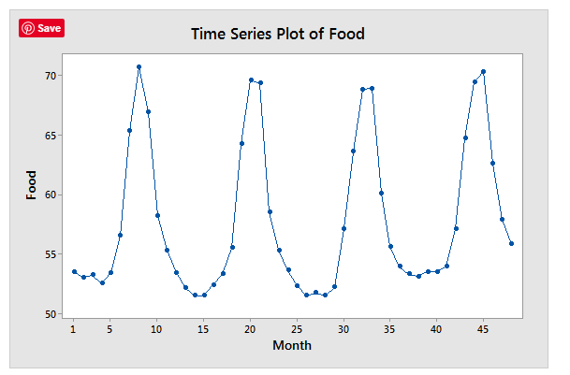
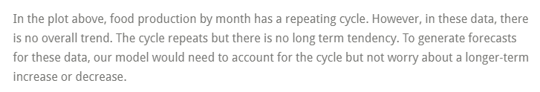
Seasonal Cycles
Seasonal cycles are patterns that repeat within a time series. Typically, they have a fixed length. Understanding seasonal cycles requires using your subject-area knowledge. For example, an analyst might note a weekly cycle where weekends tend to have higher retail sales than weekdays due to a higher number of store patrons. Alternatively, sales of summer products will tend to peak in the summer months and decline in the other months. To model these data accurately, analysts need to understand these cycles.
The examples below illustrate two datasets with seasonal cycles

Slide 19
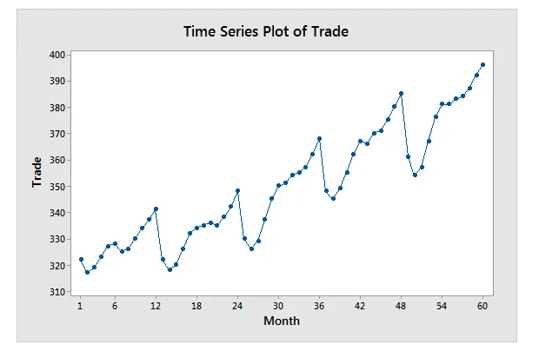
The graph for trade activity by month displays both a seasonal cycle and a long-term trend. There’s a repeating pattern and a tendency to increase over time. For these data, our model would need to account for both components.
While time series plots are straightforward, they can yield a great deal of information about how a metric changes over time.

Slide 20
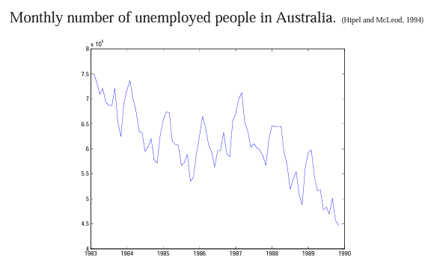
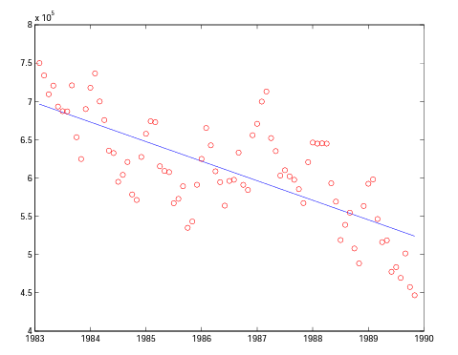
Objectives of Time Series Analysis ( Unemployment data)
Unemployment data
Trend

Slide 21
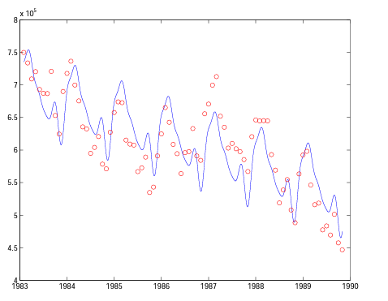
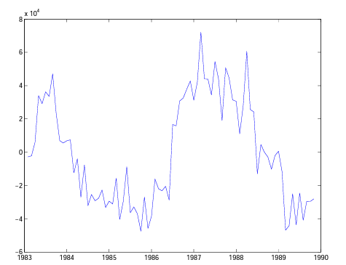
Residuals
Trend plus seasonal variation

Slide 22
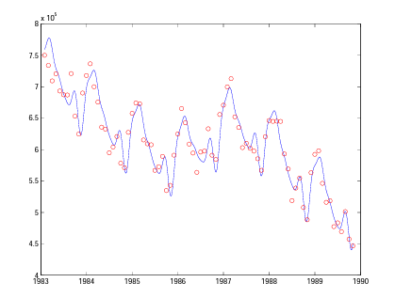
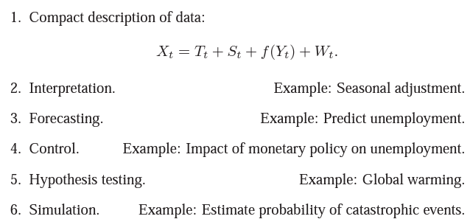
Predictions based on a (simulated) variable
Objectives of Time Series Analysis

Slide 23
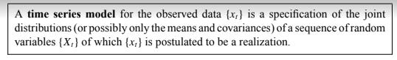
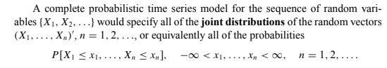
Some Simple Time Series Models
An important part of the analysis of a time series is the selection of a suitable probability model (or class of models) for the data. To allow for the possibly unpredictable nature of future observations it is natural to suppose that each observation x_{t} is a realized value of a certain random variable X_{t} .

Slide 24
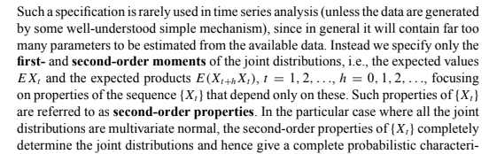

Slide 25
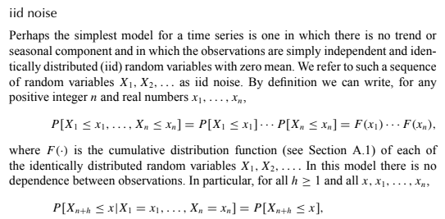
Some Zero-Mean Models

Slide 26
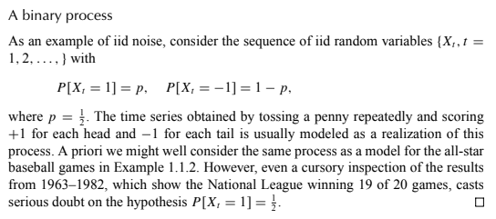
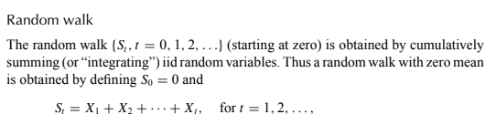

Slide 27
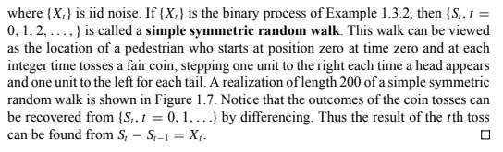

Slide 28
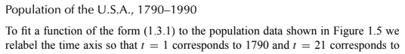
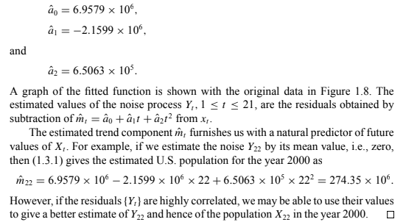

Slide 29
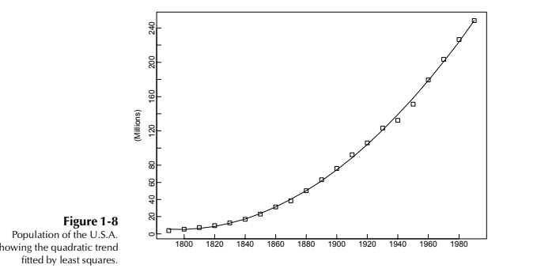

Slide 30
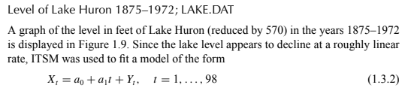
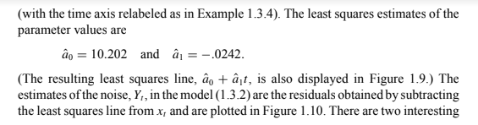
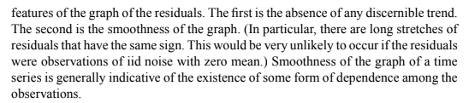

Slide 31
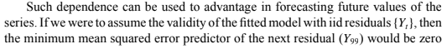
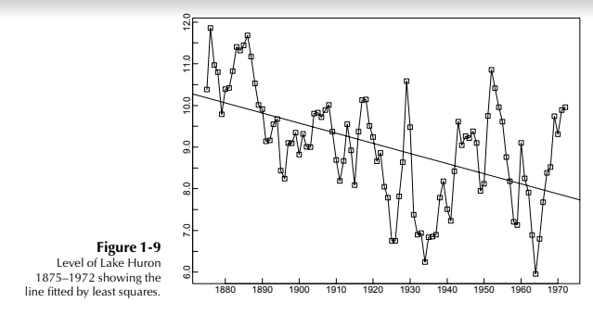
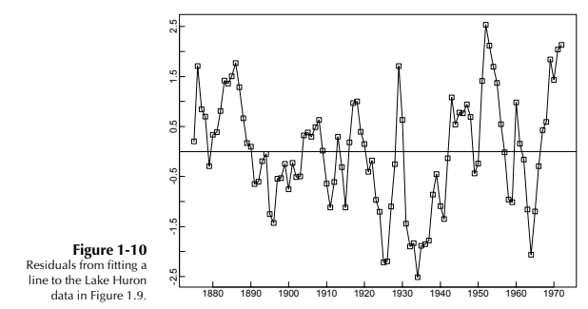

Slide 32
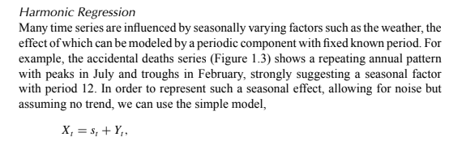
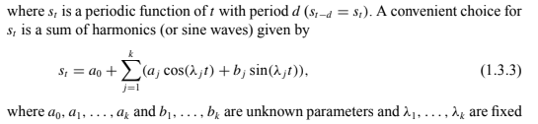

Slide 33
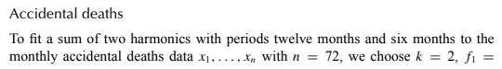
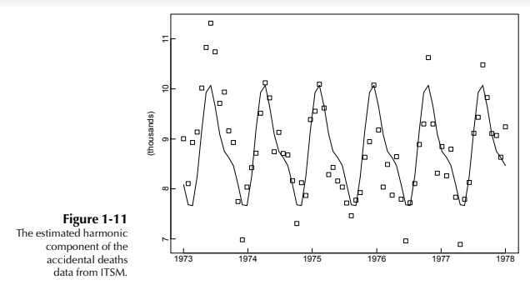

Slide 34
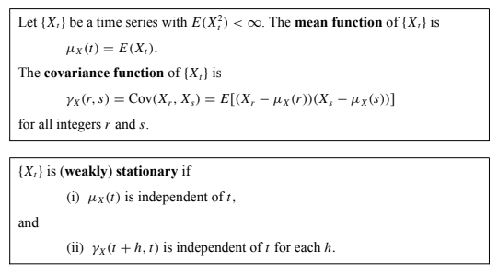
Stationary Models and the Autocorrelation Function

Slide 35
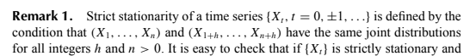
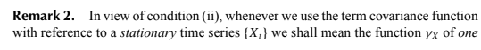
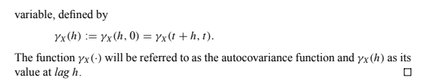
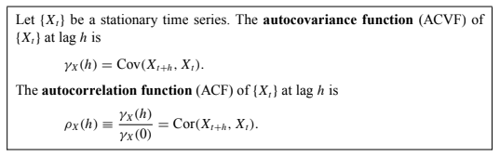

Slide 36
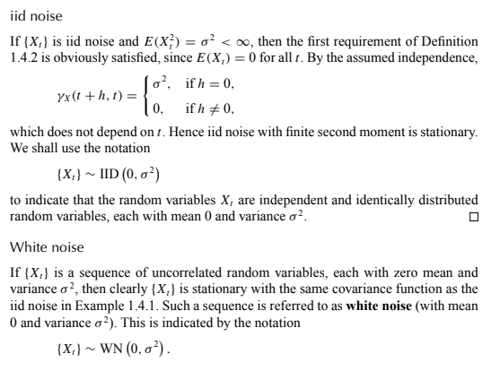

Slide 37


Slide 38


Slide 39


Slide 40

The Sample Autocorrelation Function

Slide 41


Slide 42



Example
Hence, approximately 95% of the sample autocorrelations should fall between the bounds ±1.96/√n (since 1.96 is the .975 quantile of the standard normal distribution). Therefore, in Figure 1.13 we
would expect roughly 40(.05) 2 values to fall outside the bounds.

Slide 43





Slide 44



Estimation and Elimination of Trend and Seasonal Components

Slide 45



Slide 46



OPTIONS FOR ESTIMATION

Slide 47

wherein we are given a dynamic equation relating to the value y takes on at date t to another variable
and to the value y took on in the previous period. This is a first-order difference equation because only the first lag of the variable (y_{t-1}) appears in the equation. Note that it expresses y_{t}, as a linear function of y_{t-1} and u_{t} (or w_{t} )
Goldfeld's (1973) estimated money demand function for the United States . Goldfeld's model related the log of the real money holdings of the public (m,) to the log of aggregate real income (I_{t}), the log of the interest rate on bank accounts (r _{bt}), and the log of the interest rate on commercial paper (r_{ct}):
m_{t} = 0.27 + 0.72m_{t-1} + 0.19I_{t} - 0.045r_{bt} - 0.019r_{ct}·
This is a special case with y_{t} = m_{t} and ψ₁ = 0.72

Slide 48

Solving a Difference Equation by Recursive Substitution

Slide 49


Slide 50


Slide 51


Dynamic Multipliers

Slide 52


Slide 53


Slide 54


Slide 55



Slide 56



Slide 57


Slide 58


Slide 59


Slide 60


Slide 61


Slide 62


Slide 63


Slide 64


Slide 65


Slide 66


White Noise
The basic building block for all the processes considered in this study is a sequence

Slide 67

Moving Average Processes
A moving average is defined as an average of fixed number of items in the time series which move through the series by dropping the top items of the previous averaged group and adding the next in each successive average.
A moving average is a statistic that captures the average change in a data series over time. In finance, moving averages are often used by technical analysts to keep track of price trends for specific securities.

Slide 68


Slide 69


Slide 70


Slide 71


Slide 72

share the same autocorrelation function.

Slide 73


Slide 74



Slide 75


Slide 76



Slide 77



Slide 78


Slide 79


Slide 80


Slide 81


Slide 82
Autoregressive Model
A statistical model is autoregressive if it predicts future values based on past values. For example, an autoregressive model might seek to predict a stock's future prices based on its past performance.
Autoregressive models predict future values based on past values.
They are widely used in technical analysis to forecast future security prices.
Autoregressive models implicitly assume that the future will resemble the past.
Therefore, they can prove inaccurate under certain market conditions, such as financial crises or periods of rapid technological change.
Autoregressive models operate under the premise that past values have an effect on current values, which makes the statistical technique popular for analyzing nature, economics, and other processes that vary over time. Multiple regression models forecast a variable using a linear combination of predictors, whereas autoregressive models use a combination of past values of the variable.

Slide 83
An AR(1) autoregressive process is one in which the current value is based on the immediately preceding value, while an AR(2) process is one in which the current value is based on the previous two values. An AR(0) process is used for white noise and has no dependence between the terms. In addition to these variations, there are also many different ways to calculate the coefficients used in these calculations, such as the least squares method.
These concepts and techniques are used by technical analysts to forecast security prices. However, since autoregressive models base their predictions only on past information, they implicitly assume that the fundamental forces that influenced the past prices will not change over time. This can lead to surprising and inaccurate predictions if the underlying forces in question are in fact changing, such as if an industry is undergoing rapid and unprecedented technological transformation.
Nevertheless, traders continue to refine the use of autoregressive models for forecasting purposes. A great example is the Autoregressive Integrated Moving Average (ARIMA), a sophisticated autoregressive model that can take into account trends, cycles, seasonality, errors, and other non-static types of data when making forecasts.

Slide 84
Example of an Autoregressive Model
Autoregressive models are based on the assumption that past values have an effect on current values. For example, an investor using an autoregressive model to forecast stock prices would need to assume that new buyers and sellers of that stock are influenced by recent market transactions when deciding how much to offer or accept for the security.
Although this assumption will hold under most circumstances, this is not always the case. For example, in the years prior to the 2008 Financial Crisis, most investors were not aware of the risks posed by the large portfolios of mortgage-backed securities held by many financial firms. During those times, an investor using an autoregressive model to predict the performance of U.S. financial stocks would have had good reason to predict an ongoing trend of stable or rising stock prices in that sector.
However, once it became public knowledge that many financial institutions were at risk of imminent collapse, investors suddenly became less concerned with these stocks' recent prices and far more concerned with their underlying risk exposure. Therefore, the market rapidly revalued financial stocks to a much lower level, a move which would have utterly confounded an autoregressive model.
It is important to note that, in an autoregressive model, a one-time shock will affect the values of the calculated variables infinitely into the future. Therefore, the legacy of the financial crisis lives on in today’s autoregressive models.

Slide 85

Autoregressive Series

Slide 86


Slide 87




Slide 88


Slide 89


Slide 90



Slide 91


Slide 92


Autoregressive Moving Average Series

Slide 93




Slide 94



Slide 95

We can now summarize our findings about the existence and nature of the stationary solutions of the ARMA(1,1)

Slide 96


[
]

Slide 97


difference equations.

Slide 98

Autoregressive Moving Average Series

Slide 99


Slide 100


Slide 101


Slide 102


Slide 103


Slide 104


Slide 105


Slide 106


Slide 107


Slide 108


Slide 109


Slide 110


Slide 111


Slide 112


Slide 113


Slide 114


Slide 115


Slide 116


Slide 117


Slide 118


Slide 119


Slide 120
The first step in the Box-Jenkins procedure is to difference the time series until it is stationary, thereby ensuring that trend and seasonal components are removed. In many instances one or two stage differencing is sufficient. The differenced series will be shorter than the source series by c time steps, where c is the range of the differencing. An ARMA model is then fitted to the resulting time series. Because ARIMA models have three parameters there are many variations to the possible models that could be fitted. However, the decision on what these parameters should be can be guided by a number of basic principles: (i) the model should be as simple as possible, i.e. contain as few terms as possible, which in turn means the values of p and q should be small; (ii) the fit to historic data should be as good as possible, i.e. the size of the squared differences between the estimated value at any past time period and the actual value, should be minimized (least squares principle) — the residuals from the selected model can then be examined to see if any remaining residuals are significantly different from 0 (see further, below); (iii) the measured partial autocorrelation at lags 1,2,3.... should provide an indication of the order of the AR component, i.e. the value chosen for q; (iv) the shape of autocorrelation function (acf) plot can suggest the type of ARIMA model required — the table below provides guidance on interpreting the form of the acf in terms of model selection.

Slide 121


Slide 122


Slide 123


Slide 124



Slide 125


Slide 126



Slide 127


Slide 128



Slide 129



Slide 130


Slide 131



Slide 132

Forecasts: Infinite Observations

Slide 133

constant

Slide 134


Slide 135


Slide 136

Example: Forecasting AR(1) Series

Slide 137

Example: Forecasting MA(1) Series

Slide 138

Example: Forecasting MA(q) Series

Slide 139

Forecasts: Finite Observations

Slide 140

Exact Finite-Sample Forecasts

Slide 141


Slide 142

Time Series Decomposition

Slide 143


Slide 144


Principles of decomposition
Decomposition models

Slide 145


Slide 146


Slide 147



Slide 148

Additive decomposition

Slide 149


Slide 150

Multiplicative decomposition

Slide 151



Slide 152


Wold decomposition holds for deterministic and one stochastic process MA(1) process as it can be written as a sum of one stochastic and one deterministic component.

Slide 153

Differencing

Slide 154


Slide 155


Slide 156


Slide 157


Slide 158

Identification

Slide 159


Slide 160


Slide 161

Partial Autocorrelations

Slide 162


Slide 163

: Parameter Estimation in Time Series Models

Slide 164

Model Estimation

Slide 165

Estimation of AR Models

Slide 166

Conditional QMLE for AR Models

Slide 167


Slide 168

Exact QMLE for AR Models

Slide 169


Slide 170


Slide 171

Estimation of MA Models

Slide 172


Slide 173

Estimation of ARMA Models

Slide 174

Asymptotic Properties of the QMLE

Slide 175


Slide 176


Slide 177

Model Diagnostic Tests

Slide 178


Slide 179


Slide 180


Slide 181


Slide 182



Spectral Tests

Slide 183


Slide 184


Slide 185

Model Selection Criteria

Slide 186

ARIMA Models
We have already discussed the importance of the class of ARMA models for representing stationary series. A generalization of this class, which incorporates a wide range of nonstationary series, is provided by the ARIMA processes, i.e., processes that reduce to ARMA processes when differenced finitely many times.

Slide 187

useful for representing data with trend . It should be noted, however, that ARIMA processes can also be appropriate for modeling series with no trend.

Slide 188


Slide 189





Slide 190



Slide 191



Slide 192




Slide 193


Slide 194


Forecasting Stationary Time Series

Slide 195


Slide 196



Slide 197


Slide 198


Example 2.5.1

Slide 199


Slide 200

stationary process (6.1.3).

Slide 201

Vector AR (VAR) Series

Slide 202

VAR(p) Series

Slide 203


Slide 204


Slide 205

Model Estimation

Slide 206

QMLE of P

Slide 207


Slide 208

QMLE of Σ

Slide 209

Asymptotic Properties

Slide 210

Impulse Response Functions

Slide 211

Orthogonalized Impulse Response

Slide 212


Slide 213

Generalized Impulse Response

Slide 214


Slide 215

Forecast Error Variance Decomposition

Slide 216


Slide 217


Slide 218

Structural VAR Models

Slide 219



Slide 220

Recursive Model

Slide 221


Slide 222

Full Information Maximum Likelihood (FIML)

Slide 223

Non-Recursive Model

Slide 224


Slide 225


Slide 226

Brownian Motion (Wiener Process)

Slide 227

Brownian Motion as the Limit of a Symmetric Random Walk

Slide 228


Slide 229


Slide 230


Slide 231


Slide 232



Slide 233



Slide 234

The above construction can be made more rigorous.

Slide 235



Slide 236


Slide 237


Weak Convergence

Slide 238


Slide 239


Slide 240


Slide 241


Slide 242


Slide 243


Slide 244


Slide 245


Slide 246


Slide 247


Slide 248


Slide 249


Slide 250


Slide 251


Slide 252


Slide 253

Non-Stationary Time Series
Functional Central Limit Theorem

Slide 254


Slide 255


Slide 256


Slide 257


Slide 258

I(1) Series

Slide 259


Slide 260

ARIMA vs. ARMA Series

Slide 261

I(1) vs. Trend Stationarity

Slide 262

Autoregression of I(1) Series

Slide 263

Asymptotic Properties of the OLS Estimator

Slide 264


Slide 265


Slide 266


Slide 267


Slide 268

Tests of Unit Root

Slide 269


Slide 270

Dickey-Fuller distributions

Slide 271


Slide 272

Implementation

Slide 273

Phillips-Perron Tests

Slide 274


Slide 275


Slide 276

Augmented Dickey-Fuller (ADF) Tests

Slide 277

KPSS Tests

Slide 278


Slide 279


Slide 280


Slide 281


Slide 282

Spurious Regressions

Slide 283


Slide 284


Slide 285


Slide 286


Slide 287

Cointegration

Slide 288



Slide 289


Slide 290


Slide 291

Characterization of Co-Integration

Slide 292


Slide 293


Slide 294


Slide 295


Slide 296


Slide 297


Slide 298


Slide 299

Other Representations

Slide 300

Error Correction Model

Slide 301


Slide 302


Slide 303


Slide 304


Slide 305

Engle-Granger Two-Step Procedure

Slide 306


Slide 307


Slide 308


Slide 309

Tests for Co-Integration

Slide 310


Slide 311


Slide 312

Volatility Models

Slide 313


Slide 314


Slide 315


Slide 316


Slide 317


Slide 318


Slide 319


Slide 320


Slide 321


Slide 322


Slide 323


Slide 324


Slide 325


Slide 326


Slide 327


Slide 328


Slide 329


Slide 330


Slide 331


Slide 332


Slide 333


Slide 334


Slide 335


Slide 336


Slide 337


Slide 338


Slide 339


Slide 340


Slide 341


Slide 342


Slide 343


Slide 344


Slide 345


Slide 346


Slide 347


Slide 348


Slide 349


Slide 350


Slide 351


Slide 352


Slide 353


Slide 354


Slide 355


Slide 356


Slide 357


Slide 358


Slide 359


Slide 360


Slide 361


Slide 362


Slide 363


Slide 364


Slide 365


Slide 366


Slide 367


Slide 368


Slide 369


Slide 370


Slide 371


Slide 372


Slide 373


Slide 374


Slide 375


